Slide 1
Is it Reasonable to Believe in God, Jesus, and the Bible?
Did the Bible come from God?
The Proof is in the Prophecies!

Slide 2
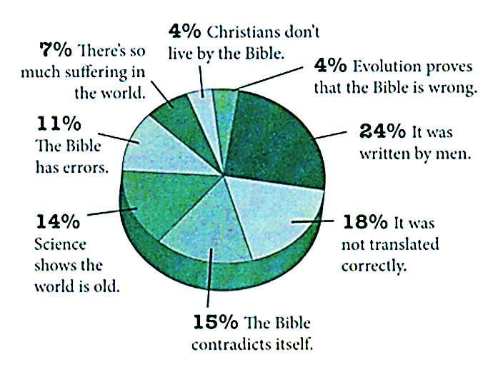
Survey of 1,000 young adults
who left their “Christian” faith.
Already Gone,
Ham & Beemer, 2009

Slide 3
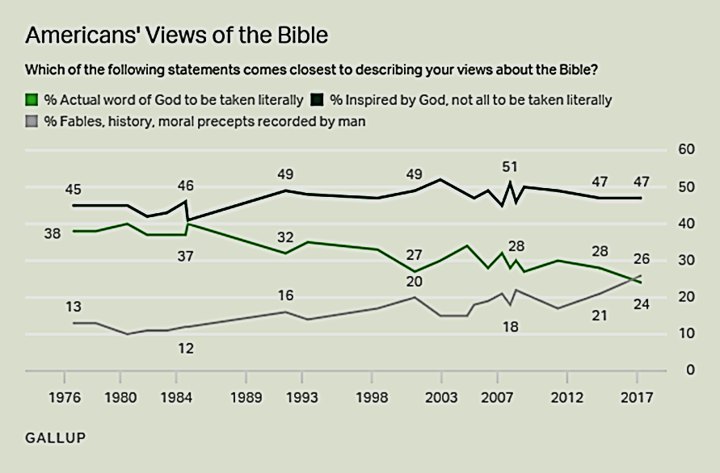
May 15, 2017

Slide 4
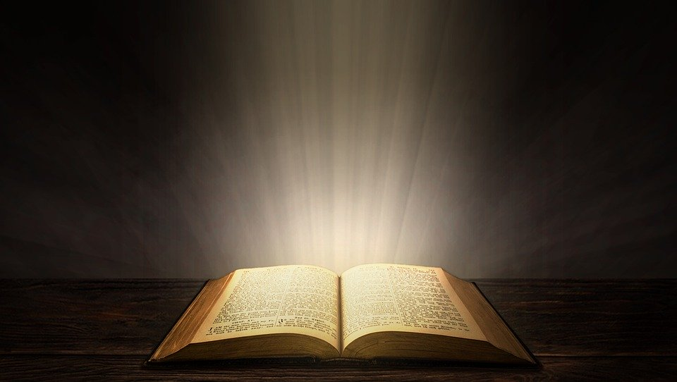
Proof that the Bible Came from God
Fulfilled Prophecy
The prophecies contained in Scripture may be the most solid evidence there is for the inspiration of the Bible.
Although Peter was certain about the identity of Christ because he was an eyewitness of “His majesty”, he indicates that the prophetic word is even stronger evidence (2 Peter 1:16-21).

Slide 5
Proof that the Bible Came from God
Fulfilled Prophecy
The Bible foretells future events with accuracy, often hundreds of years before they occur.
Only a true and living God has such power! (Isaiah 46:9-10; 42:9).
The fact that the Bible is filled with such accurate prophecies demonstrates that it is a product of the mind of God!

Slide 6
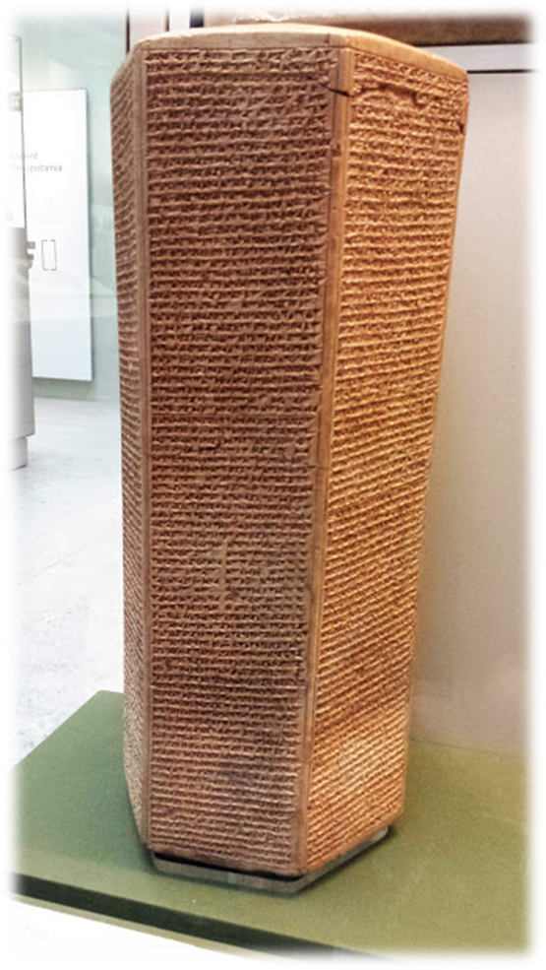
Proof that the Bible Came from God
Prophecies Concerning Nations & Kings
#1 Babylonian Captivity. 100 years before it happened, Isaiah prophesied that Babylon would conquer Jerusalem and take its royal children and riches into captivity (Isaiah 39:5-7).
Hezekiah was King of Judah from 715-686 BC.
His name is mentioned in records of the Assyrian King Sennacherib in this time period.
The Babylonians themselves recorded the fulfillment of Isaiah’s prophecy!

Slide 7
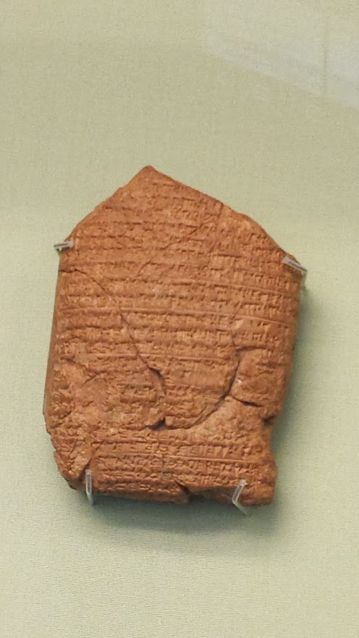
The Babylonian Chronicles
“In the seventh year [of Nebuchadnezzar, 598 BC] in the month Chislev [November/December] the king of Babylon assembled his army, and after he had invaded the land of Hatti [Syria/Palestine] he laid siege to the city of Judah. On the second day of the month of Adar he conquered the city and took the king [Jeconiah] prisoner. He installed in his place a king of his own choice, and after he had received rich tribute, he sent forth to Babylon.” (No 24 WA21946, The Babylonian Chronicles, The British Museum)

Slide 8
Proof that the Bible Came from God
Prophecies Concerning Nations & Kings
#2 Return from Captivity. Long before Cyrus was born, the Scriptures identify him as the Persian king who would allow Israel to return from captivity (Isaiah 44:24-28; Ezra 1:1-2, cf. Jeremiah 29:10).
Critics and sceptics claim that this portion of Isaiah was written AFTER the events it prophesies.
Liberal scholars consider “the Book of Isaiah to be an anthology, the two principal compositions of which are the Book of Isaiah proper (chapters 1-39), containing the words of the prophet Isaiah himself, dating from the time of the First Temple, around 700 BCE, and Second Isaiah (chapters 40-66) comprising the words of an anonymous prophet, who lived some one hundred and fifty years later” (http://dss.collections.imj.org.il/isaiah)

Slide 9
Isaiah 39 & 40 from the Isaiah Scroll This copy of Isaiah is dated circa 200 BC. Isaiah 40 begins immediately after Isaiah 39 in the same column.

Slide 10
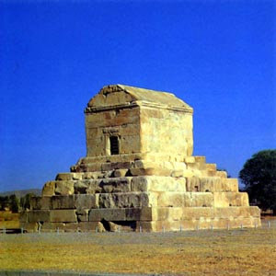
Tomb of Cyrus (Isaiah 44:28)
“O man, whoever you are and wherever you come from, for I know that you will come – I am Cyrus, son of Cambyses, who founded the Empire of the Persians and was king of the East. Do not grudge me this spot of earth which covers my body." - Cyrus

Slide 11
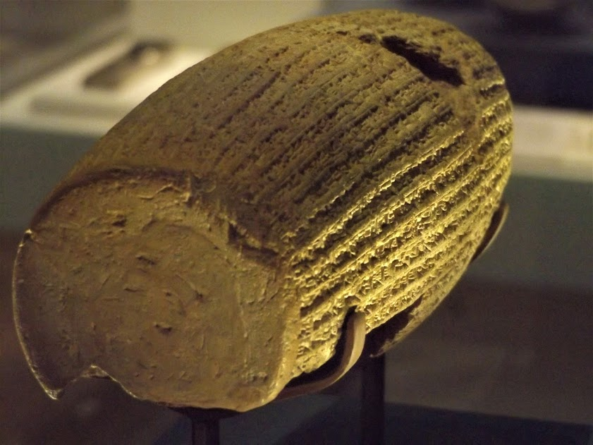
The Cyrus Cylinder records the program of religious tolerance of King Cyrus (Isa. 44:28; Ezra 1)
Partial Translation of the Cyrus Cylinder "I am Cyrus, king of the world, great king, mighty king, king of Babylon, king of the land of Sumer and Akkad, king of the four quarters, son of Cambyses… The citizens of Babylon ...their dilapidated dwellings I restored. I put an end to their misfortunes... the cities of Ashur and Susa, Agade, Eshnuna, the cities of Zamban, Meurnu, Der, as far as the region of the land of Gutium, the holy cities beyond the Tigris whose sanctuaries had been in ruins over a long period, the gods whose abode is in the midst of them, I returned to the places and housed them in lasting abodes. I gathered together all their inhabitants and restored to them their dwellings..."

Slide 12
Proof that the Bible Came from God Prophecies concerning Nations & Kings
#3 Ezekiel’s Prophecy Against Tyre (Ezekiel 26)
Tyre is condemned because she gloated over the fall of Jerusalem (26:1-2)
The prophecy includes details of several unlikely occurrences:
Many nations come in waves against Tyre
It would be made a bare rock
It would become a place for spreading nets in the midst of the sea
Nebuchadnezzar would destroy the mainland city and villages
The city would not be rebuilt

Slide 13
A Careful Look at Ezekiel 26:1-14
Ezekiel 26:3-5: What many nations will do to Tyre.
The Lord will cause many nations to come up against Tyre.
They will destroy walls, break down towers, etc.
Tyre will be a place to spread nets and spoils for the nations.
Ezekiel 26:6-11: What Nebuchadnezzar will do.
Also daughter villages will be destroyed.
FOR the Lord will bring Nebuchandnezzar.
He will ravage settlements and destroy defenses.
He will slay your people.
Ezekiel 26:12-14: What they and the Lord will do.
They will plunder and loot and put timber, stones, and soil in the midst of the water.
The Lord will put an end to music and songs, make Tyre a bare rock, a place for spreading nets, never to be rebuilt.

Slide 14
Proof that the Bible Came from God Prophecies concerning Nations & Kings
The Prophecy Against Tyre
The actions of Nebuchadnezzar’s army are detailed in Ezekiel 26:7-11
Years later, Ezekiel was informed that Nebuchadnezzar’s army did not completely destroy Tyre, but his efforts against Tyre were the Lord’s work and would be rewarded (29:18-20).
Josephus, quoting “the records of the Phoenicians,” says that Nebuchadnezzar “besieged Tyre for thirteen years in the days of Ithobal, their king” (Against Apion, 1.21).

Slide 15
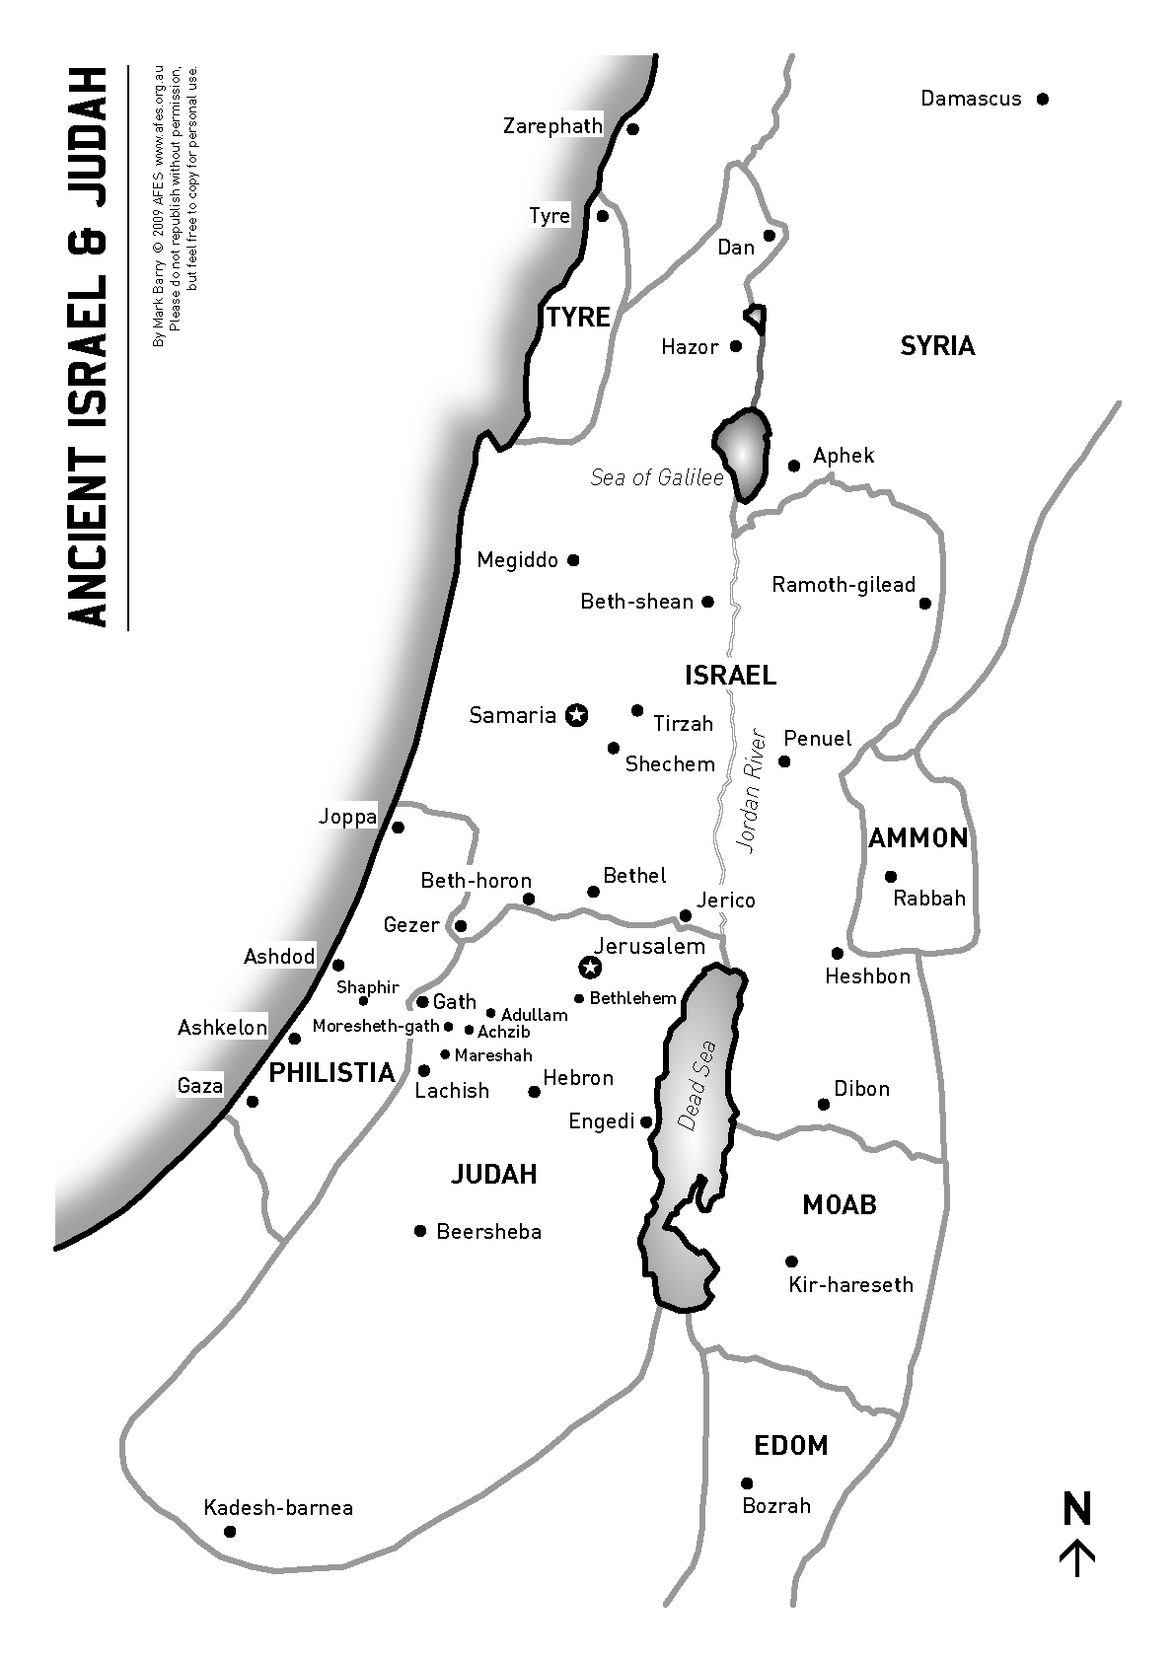
The prophecy against Tyre found in Ezekiel 26:3-5 and 11-14 was fulfilled in detail by Alexander the Great during his campaign through Palestine in 332 BC

Slide 16
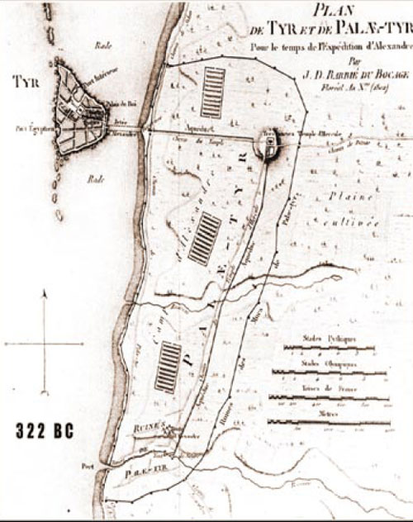
Map of Tyre before 332 B.C.
Prior to Alexander the Great’s construction of the causeway, Tyre was an island 1/3 mile (600 m) offshore. The mainland city stretched several miles to the south.

Slide 17
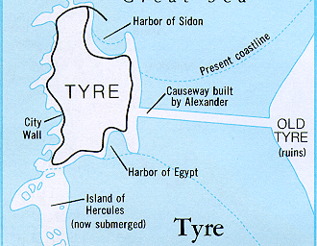
Alexander wished to make a personal sacrifice in the temple of Heracles (Hercules) on the island city of Tyre. The Tyrians refused his request. Upon receiving their refusal, Alexander immediately set to work on a plan to conquer the city. He determined to build a land bridge or causeway (“mole”) from the mainland city of Tyre to the island city. Siculus stated: “Immediately he demolished what was called Old Tyre and set many tens of thousands of men to work carrying stones to construct a mole” (17.40). Even though this action was unprecedented militarily, it was exactly what one might expect from the description of the destruction of Tyre given by Ezekiel hundreds of years before. The mainland city was demolished and all her stones, timber, and soil were thrown into the midst of the sea. (Kyle Butt, AplogeticsPress.org., Tyre in Prophecy, 2006)
The historian Diodorus Siculus lived from 80-20 B.C. and wrote extensively of Alexander the Great’s dealings with Tyre. The synopsis at right is derived from the records of Diodorus Siculus.

Slide 18
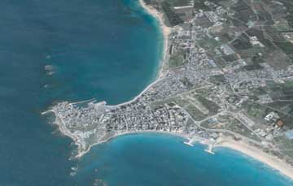
Aerial photo of modern Tyre

Slide 19
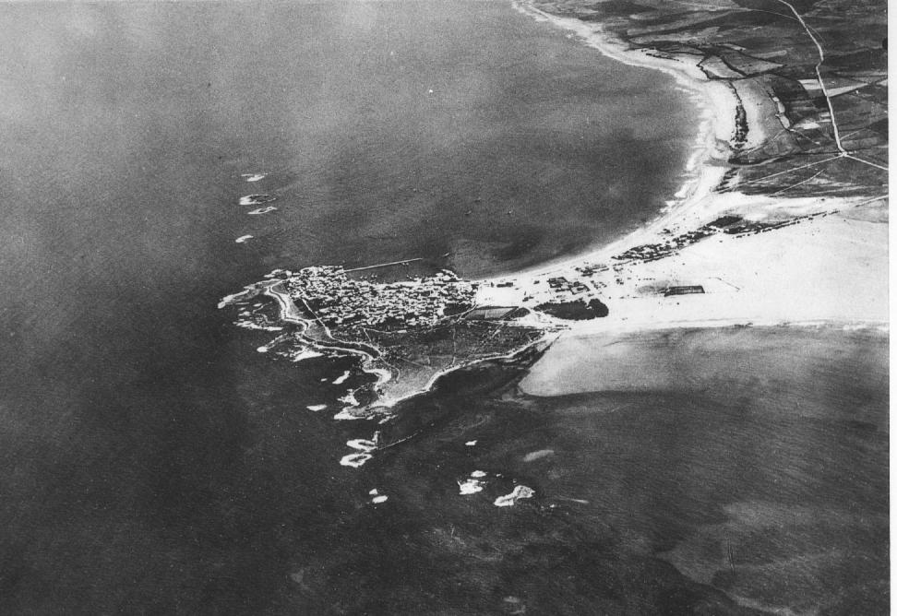
Aerial photo of Tyre taken in 1934

Slide 20
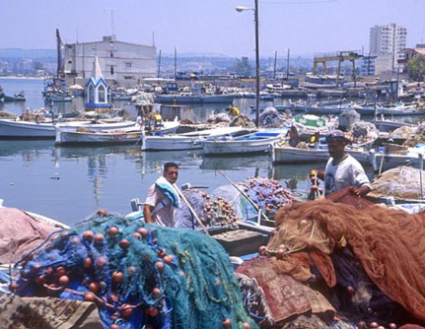
TYRE A Place for Spreading Nets in the midst of the sea
Port of Tyre
Local fishermen still ply their ancient trade. Here we see their boats, floating over and beside the ruins of ancient Tyre, with nets drying in fulfillment of Ezekiel’s prediction that Tyre would “become a place to spread fishnets” (Ezekiel 26:5, 14).

